Slide 1
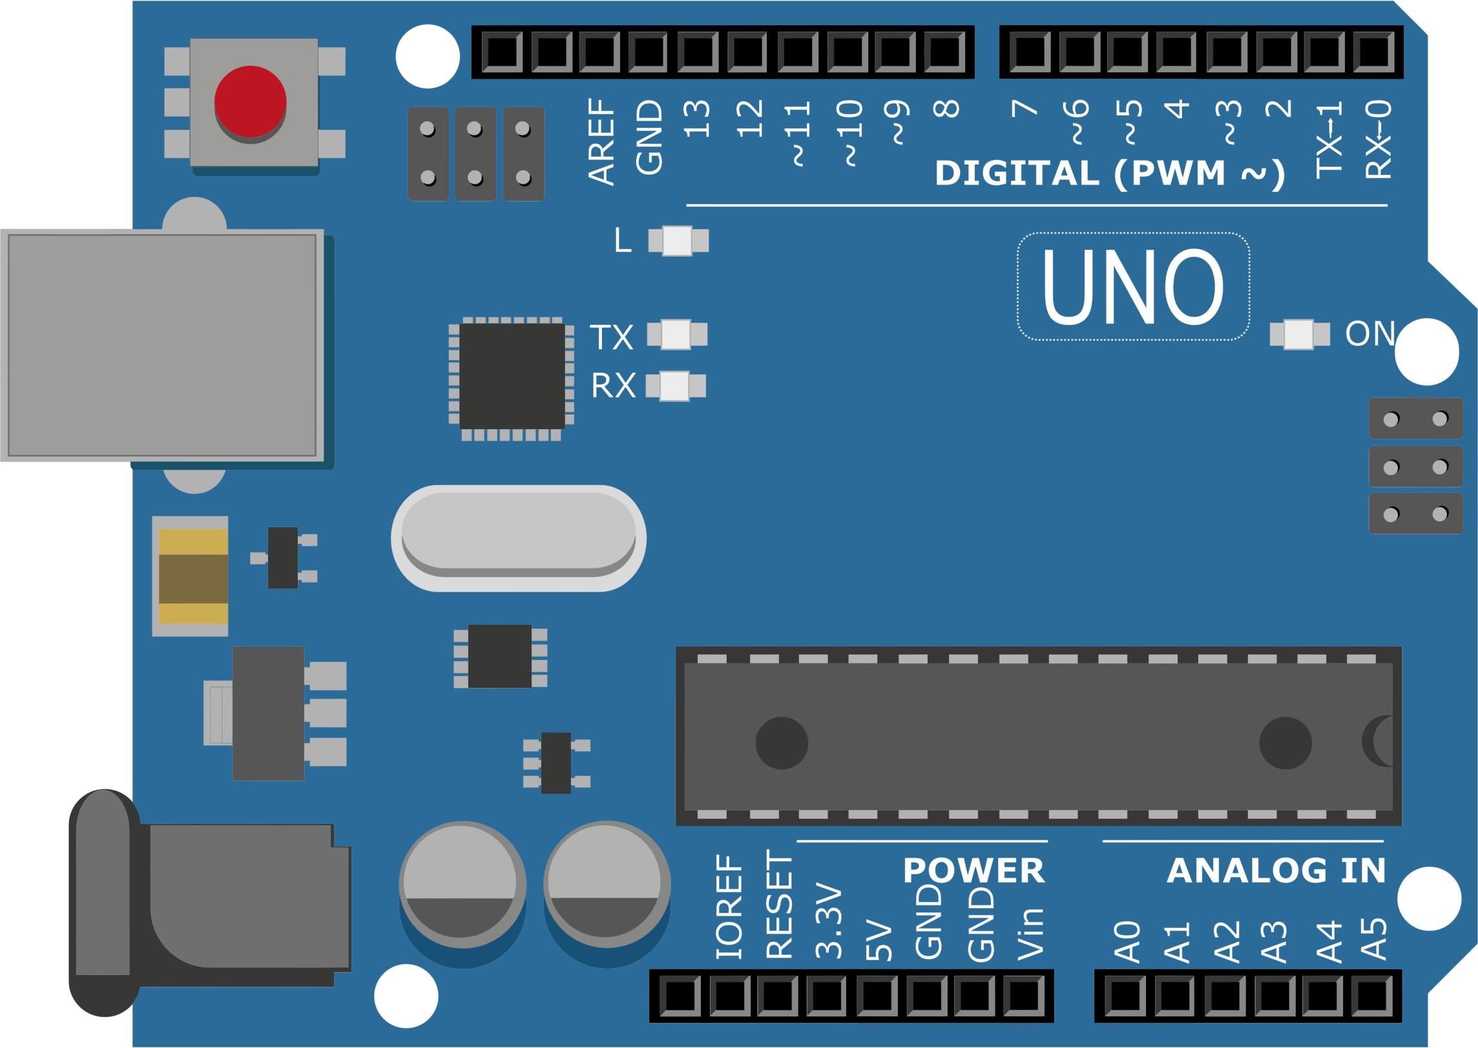
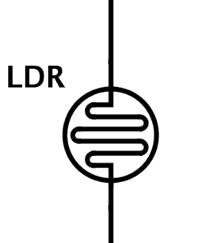


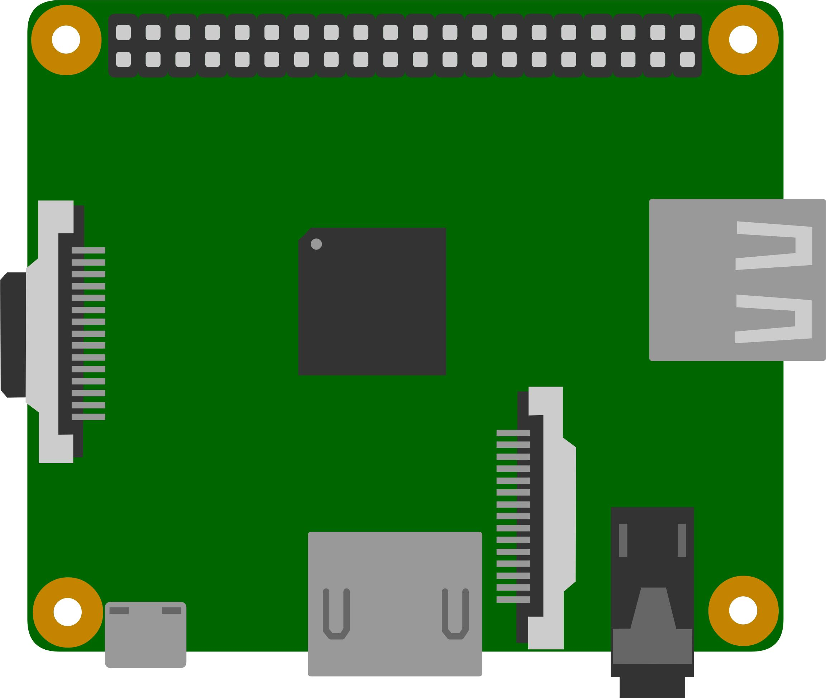

Physical system
LDR
Background illumination
LDR
Arduino 1
Arduino 2
I2C BUS
Serial
Monitor
Serial
Monitor
Raspberry Pi
TCP-IP
TCP-IP
Client 1
Client 2

Slide 2
Local PI Controller
Luminaire 1
LED + Sensor
Luminaire 2
LED + Sensor
Local PI Controller
Control reference
Global Controller
Global Controller
Control reference
I2C BUS
Data Server
TCP
Client

